Slide 1
Maps and Hash Maps

Slide 2
Map
A map is an ADT. Which allows us to store elements so they can be located using keys.
The motivation for such searches is that each element typically stores additional useful information besides its search key, but the only way to get at that information is to use the search key.
Specifically, a map stores key-value pairs (k,v), which we call entries, where k is the key and v is its corresponding value.
A map allows the following operations: insert(key, value), search(key) delete(key), etc.
In addition, the map ADT requires that each key be unique, so the association of keys to values defines a mapping.

Slide 3
Map
In order to achieve the highest level of generality, we allow both the keys and the values stored in a map to be of any object type.
In a map storing student records (such as the student’s name, address, and course grades), the key might be the student’s ID number.
We can implement maps using arrays, linked lists or trees.

Slide 4
Hash Map (an Implementation of MAP)
Hash map is a data structure that uses arrays to implement map.
The time complexity of insert and search operations in hash maps is typically Ω(1) for the best case and O(n) for the worst case.
A good implementation of hash map will ensure that worst case seldom occurs.
A Hash Map has two components: an array that stores each <key, value> pairs and a hash function used to determine the location of a key within the array.

Slide 5
Hash Map
The array in a hash map has some capacity n.
Whenever we insert a <key, value> pair, we first pass the key to the hash function which determines the index number i in the array where the given <key, value> pair should be inserted.

Slide 6
Hash Function
Suppose our keys are strings.
Now assume that a key k=“abc” with some associated value is to be inserted into the hash map.
We first pass the key to hash function.
The hash function then determines a hash code.
The hash code is then passed to a compression function to determine the index number of the key.

Slide 7
Hash Function
Assume hash function is implemented as follows:
int hashFunction(string key)
{ int hashCode=0;
for (int i=0; i<key.size(); i++)
hashCode+=key[i];
//compression function
index=hashCode % SIZE_OF_HASHMAP;
}

Slide 8

Hash Function
A hash function can be implemented in many ways:
x₀ is the character at index 0 of the key, x_{k-1} is the last character of the key. All Xs are coefficients.
a is a fixed numeric integer, usually a prime number.
k is the length of the key.
The hash code generated by this function is called polynomial hash code.

Slide 9
Hash Code and Compression Function
A hash code is generated by applying a mathematical function.
The hash code is usually out of the range of array indices.
We therefore apply a compression function to map the hash code to an index number in the array.

Slide 10

Hash Code and Compression Function
There are several compression functions.
One function (division method) has been shown previously (in the code)
Another compression function: The MAD Method
Where k is the hash code of a key. N is a prime number, and a&b are non-negative integers randomly chosen while applying the compression function, so that a%N != 0. The MAD method reduces hash collisions.

Slide 11
Hash Collision
When the hash code of two different keys become the same, it’s called a hash collision.
A Hash collision is resolved using two schemes: separate chaining and open addressing.

Slide 12
Separate Chaining
At each index of the array, we have a container/list which can store multiple <key, value> pairs.
All keys that have the same hash code will be kept in the container.

Slide 13
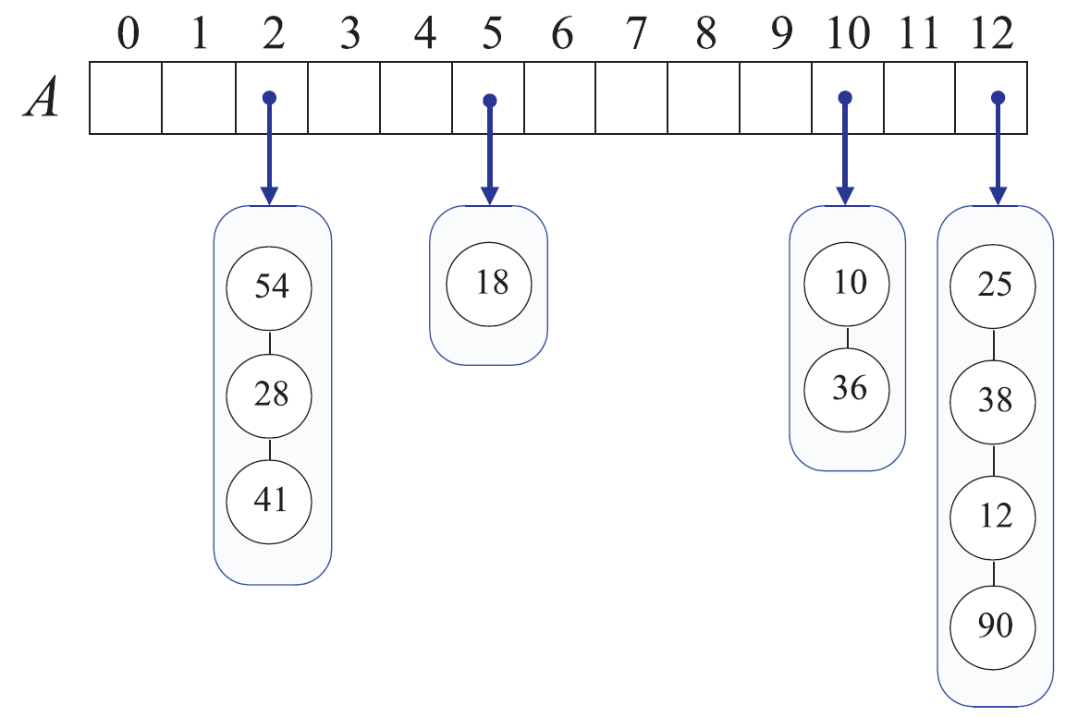
Separate Chaining

Slide 14
Open Addressing
The separate-chaining rule allows for simple implementations of map operations.
but it requires the use of an auxiliary data structure—a list—to hold entries with.
There two open addressing schemes: probing and double hash function.

Slide 15
Probing
In this method, if we try to insert an entry (k,v) into an index i where i = h(k), and index i is already occupied by some other key, then we try next at A[(i+1) mod N].
If A[(i+1) mod N] is also occupied, then we try A[(i+2) mod N],
and so on, until we find an unoccupied index that can accept the new entry.
This type of probing is linear probing, i.e., we try to find the free index using a linear search.

Slide 16
Quadratic Probing
Another open-addressing strategy, known as quadratic probing, involves iteratively finding the free index using the formula:
A[(h(k)+ f ( j)) mod N],
for j = 0,1,2, . . ., where f ( j) = j^2,

Slide 17
Double Hashing
We have two hash functions: hashFunction1(k) and hashFunction2(k). The second hash function’s value is used as an index.
index=hashFunction1(key)+ i*hashFunction2(key), for i=0, 1, 2, 3..
index= index% SIZE
Double hashing is used in conjunction with probing as evident from the above formula.

Slide 18
Load Factor
Assume we are using open addressing in a hash map
If the array in the hash map has capacity of 100, and it has 50 elements, then the load factor will be:
Load factor= total element/size= 50/100= 0.5
A higher load factor increases the probability of hash collision, i.e., when the load factor is 1, the probability of hash collision is 1.
For a good hash function, load factor is the probability of hash collision.

Slide 19
Load Factor
Generally, if load factor surpasses a certain threshold, we should increase the capacity of the array and rehash all elements.
The threshold value for load factor is usually set to be 0.75.
Rehashing the elements from the old array into the new array is necessary. For example for the old array the address returned by a hash function may be 0, but for new array it may be 100.

Slide 20
Implementation of Open Addressing-based Hash Map
Following variables are required as members of the hash map:
array of type HashItem<k,v>
capacity of type integer
totalElements of type integer
Following functions are required in the public interface of hash map.
Constructor
insert(k, v)
v get(k)
bool hasKey(k)
void remove(k)
Destructor
The following functions are required in the private interface of hash map.
int hashFunction(k)
resize()

Slide 21
Implementation of Open Addressing-based Hash Map
typename <k,v>
struct HashItem
{
k key;
v value;
int state; //kind of like isOccupied flag in Array-based Trees, but it can take 3 values (OCCUPIED, NEVER_USED & DELETED)
};
typename <k,v>
Class HashMap
{
HashItem<k,v> *arr;
int capacity;
int totalElements;
void resize();
int hashFunction();
public:
HashMap();
void insert(k key, v value);
v get(k key);
bool hasKey(k key);
bool delete(k key);
~HashMap();
};

Slide 22
Search Function in Open Addressing-based Hashmap
Search(key):
We first find the index number of key using hash function. If the key exists at that index, then we simply return the value at that index.
However, if the index does not have that key, then there is a possibility that the index exists at some other index (recall probing).
To efficiently determine whether the key exists in the hashmap or not,
instead of using a binary isOccupied flag for each index, we need to use a flag that can have 3 values, i.e. OCCUPIED, NEVER_USED & DELETED.
During our search using probing, if we encounter an index where the flag’s value is NEVER_USED, we can be sure that the key does not exist in the hash map.
Otherwise, we continue to search until we come back at the original index from where we started our search using probing.

Slide 23
Insert Function in Open Addressing-based Hash Map
Duplicate keys are not allowed in a hashmap.
If a duplicate key value pair has arrived, then we can simply discard it,
or we can update the value.
We always insert the given <key, value> pair at that index where the value of flag is either NEVER_USED or DELETED.

Slide 24
Delete Function in Open Addressing-based Hashmap
Delete(key):
It works like search function.
If the key is found, then instead of returning it, it will mark the index as DELETED
It performs lazy deletion for efficiency.

Slide 25
Implementation of Separate Chaining-based HashMap
The struct of HashItem will change as follows:
struct HashItem
{
LinkedList<k,v> items;
}

Slide 26
Chapter 9 of Data Structures & Algorithms in C++. Second Edition. Micheal T. Goodrich, Roberto Tamassia and David M.

